Slide 1


Alphabet
A to Z

Slide 2
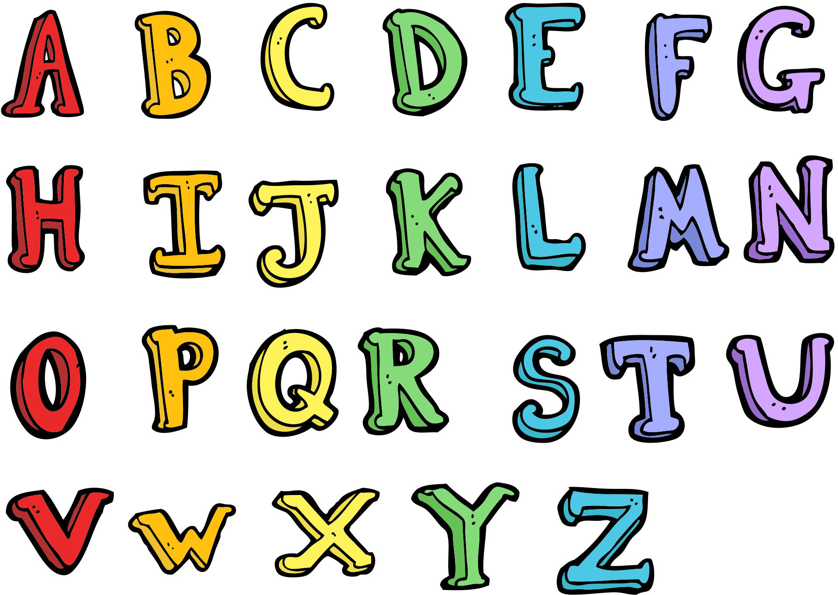

Slide 3
A is for apple.

Slide 4

B is for bicycle.

Slide 5

C is for cake.

Slide 6

D is for dog.

Slide 7

E is for elephant.

Slide 8

F is for fish

Slide 9
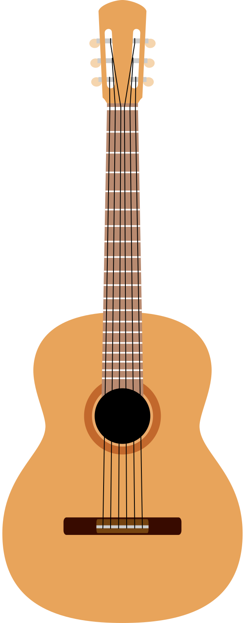
G is for guitar.

Slide 10

H is for house.

Slide 11

I is for icecream.

Slide 12

J is for jacket.

Slide 13

K is for kite.

Slide 14
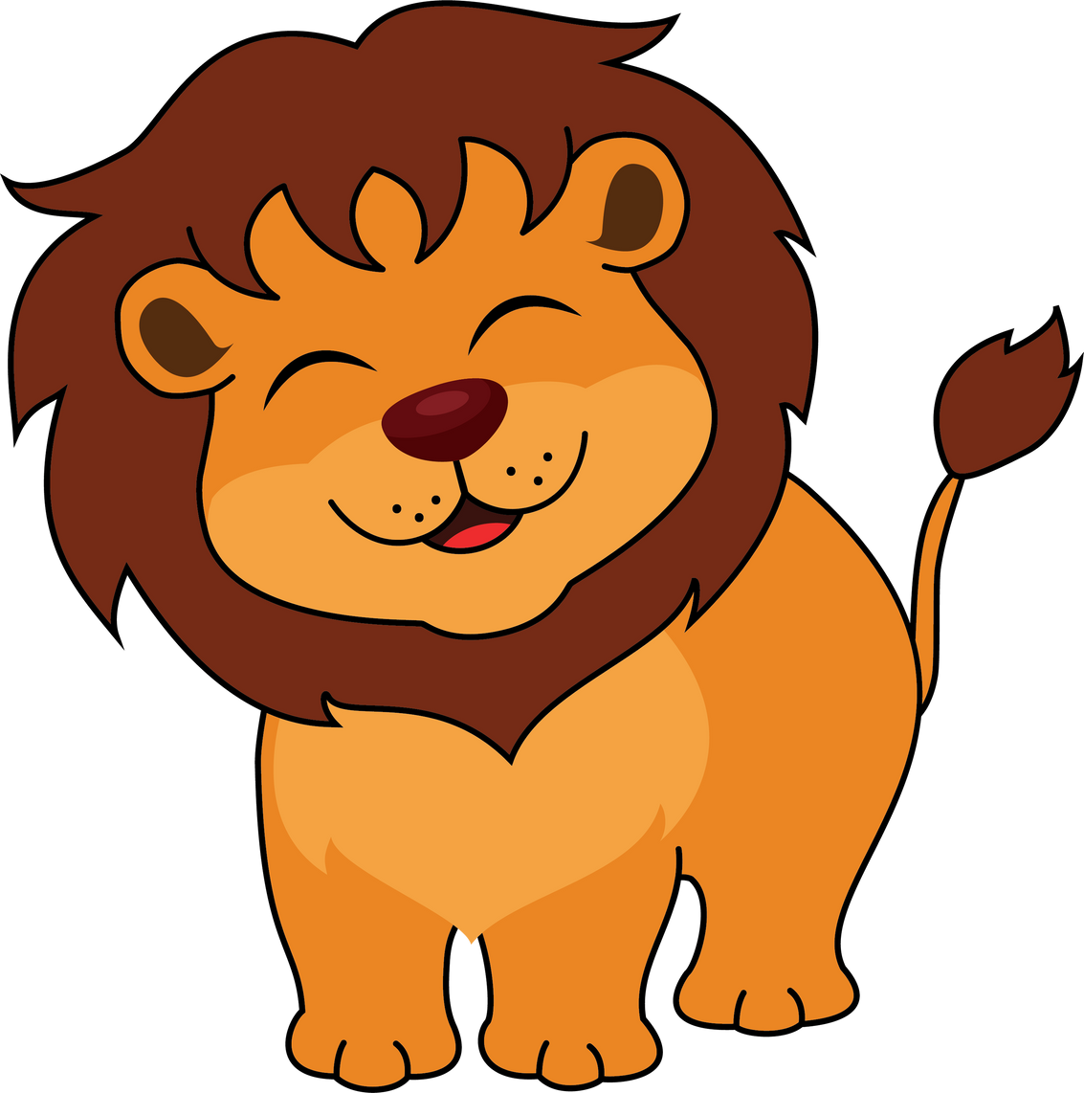
L is for lion.

Slide 15

M is for milk.

Slide 16

N is for nose.

Slide 17

O is for orange.

Slide 18

P is for pumpkin.

Slide 19

Q is for queen.

Slide 20

R is for rabbit.

Slide 21

S is for sun.

Slide 22
T is for turtle.

Slide 23

U is umbrella.

Slide 24

V is for violin.

Slide 25

W is for water.

Slide 26

X is for x-ray

Slide 27

Y is for yarn.

Slide 28

Z is for zebra.

Slide 29
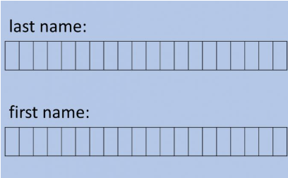
What is your name?
Kijan ou rele?
A-B-I-G-A-I-L

Slide 30
Where are you from?
Ki kote ou soti?
H-A-I-T-I
E-L S-A-L-V-A-D-O-R

